Slide 1
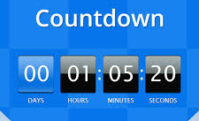
Countdown Timer
HTML, CSS, and JavaScript Implementation

Slide 2
Project Overview
This project is a Countdown Timer application.
Users can select a future date and time, and the timer will count down in real time.
It includes visual display for days, hours, minutes, and seconds.

Slide 3
HTML Structure
The HTML includes:
Title and container div
Input field for date and time
Start button
Countdown display for days, hours, minutes, and seconds
Script and style links

Slide 4
CSS Styling
CSS provides:
Gradient background and centered layout
Styled input field and button
Flex layout for the timer display
Box design for time values
Message section for countdown completion

Slide 5
JavaScript Logic
JavaScript handles:
Capturing selected date/time
Calculating time difference every second
Displaying updated countdown values
Displaying a message when countdown ends

Slide 6
Functional Flow
User selects a future date and time
Clicks 'Start' button
Countdown begins and updates every second
Message displayed when countdown completes

Slide 7
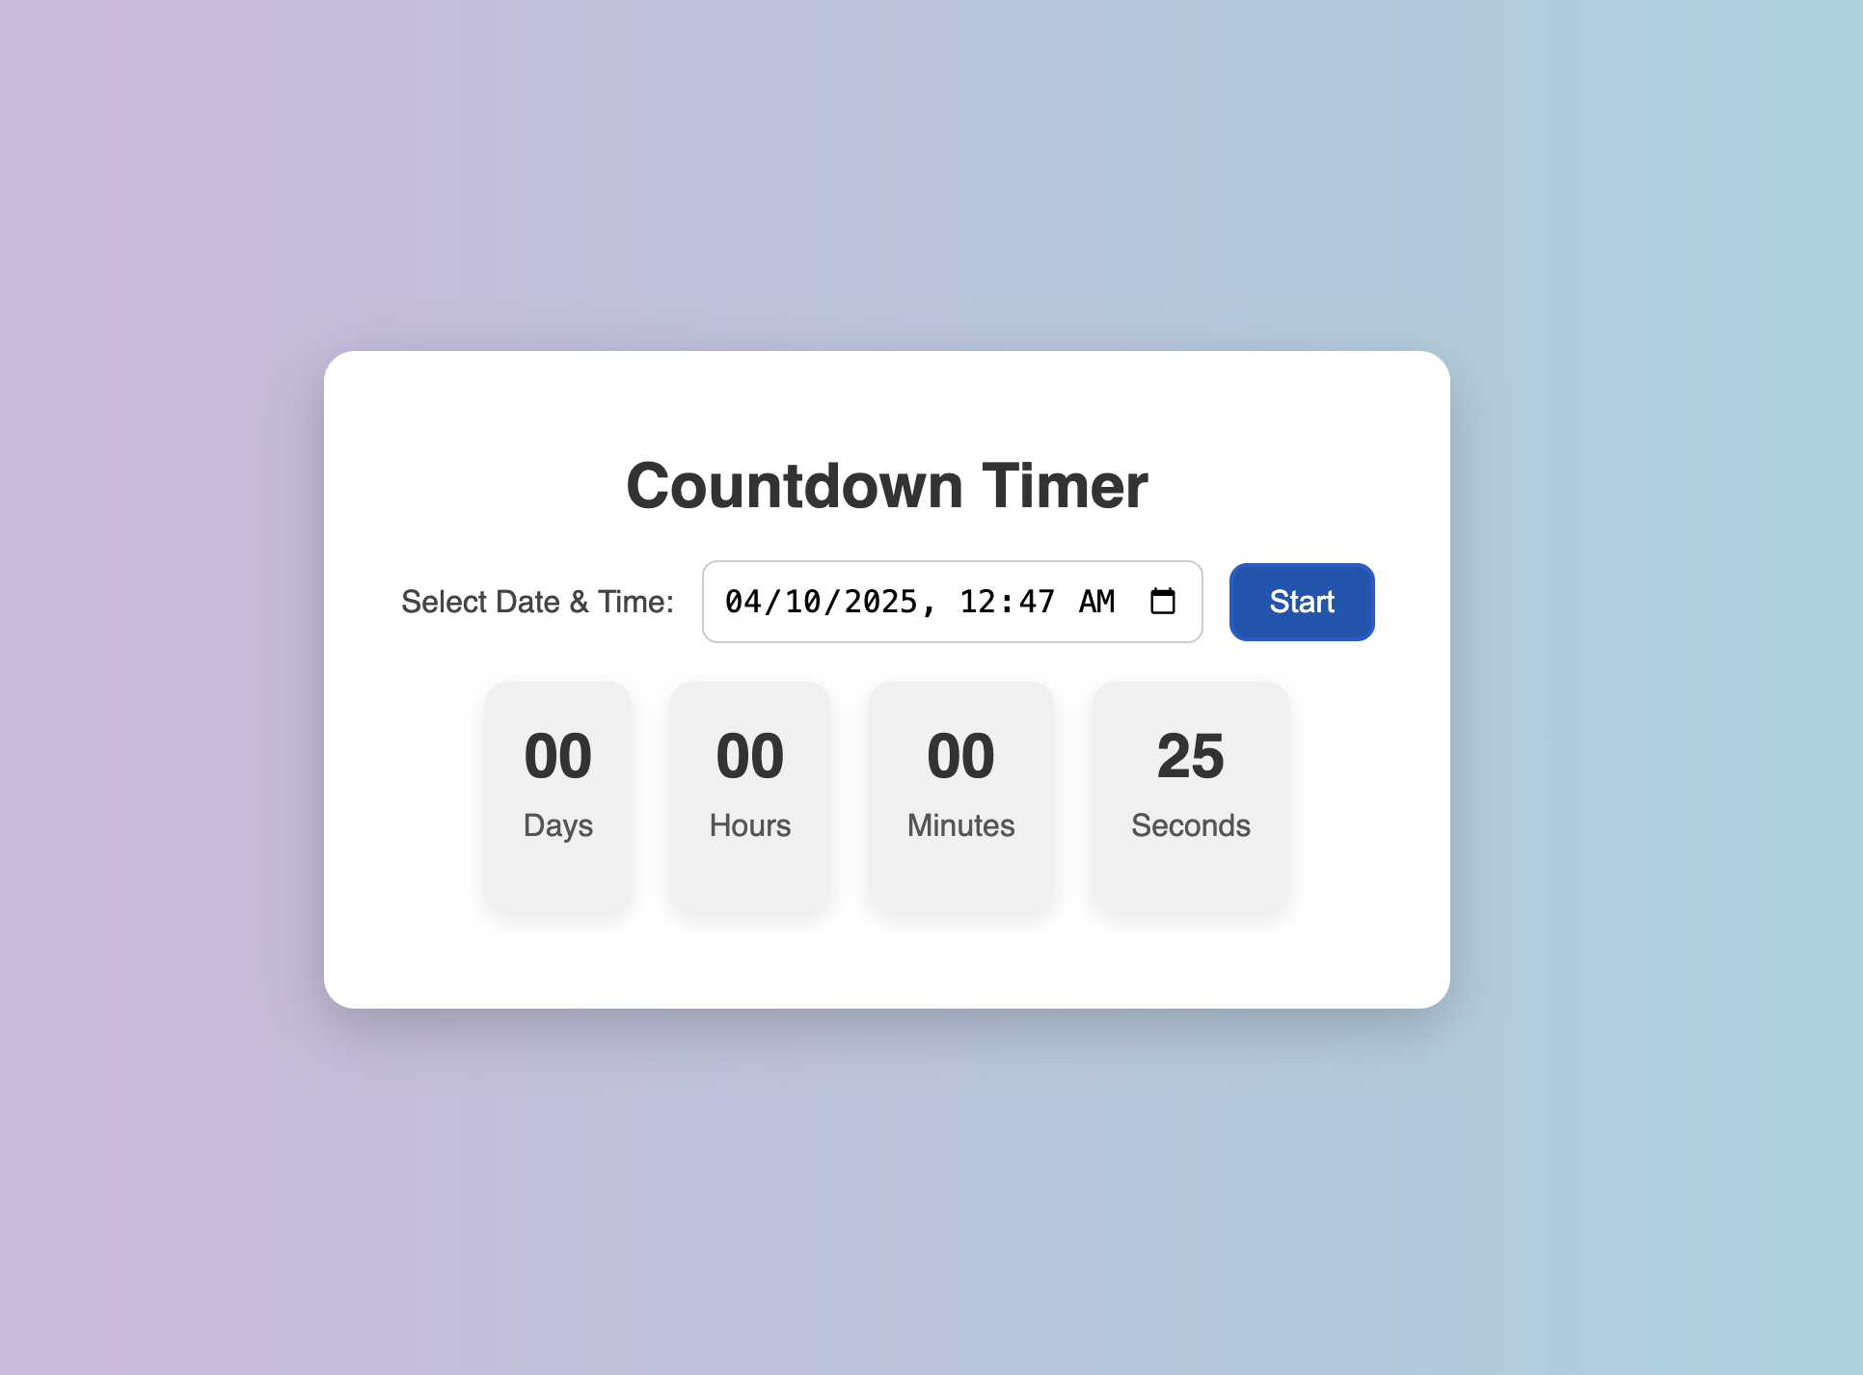
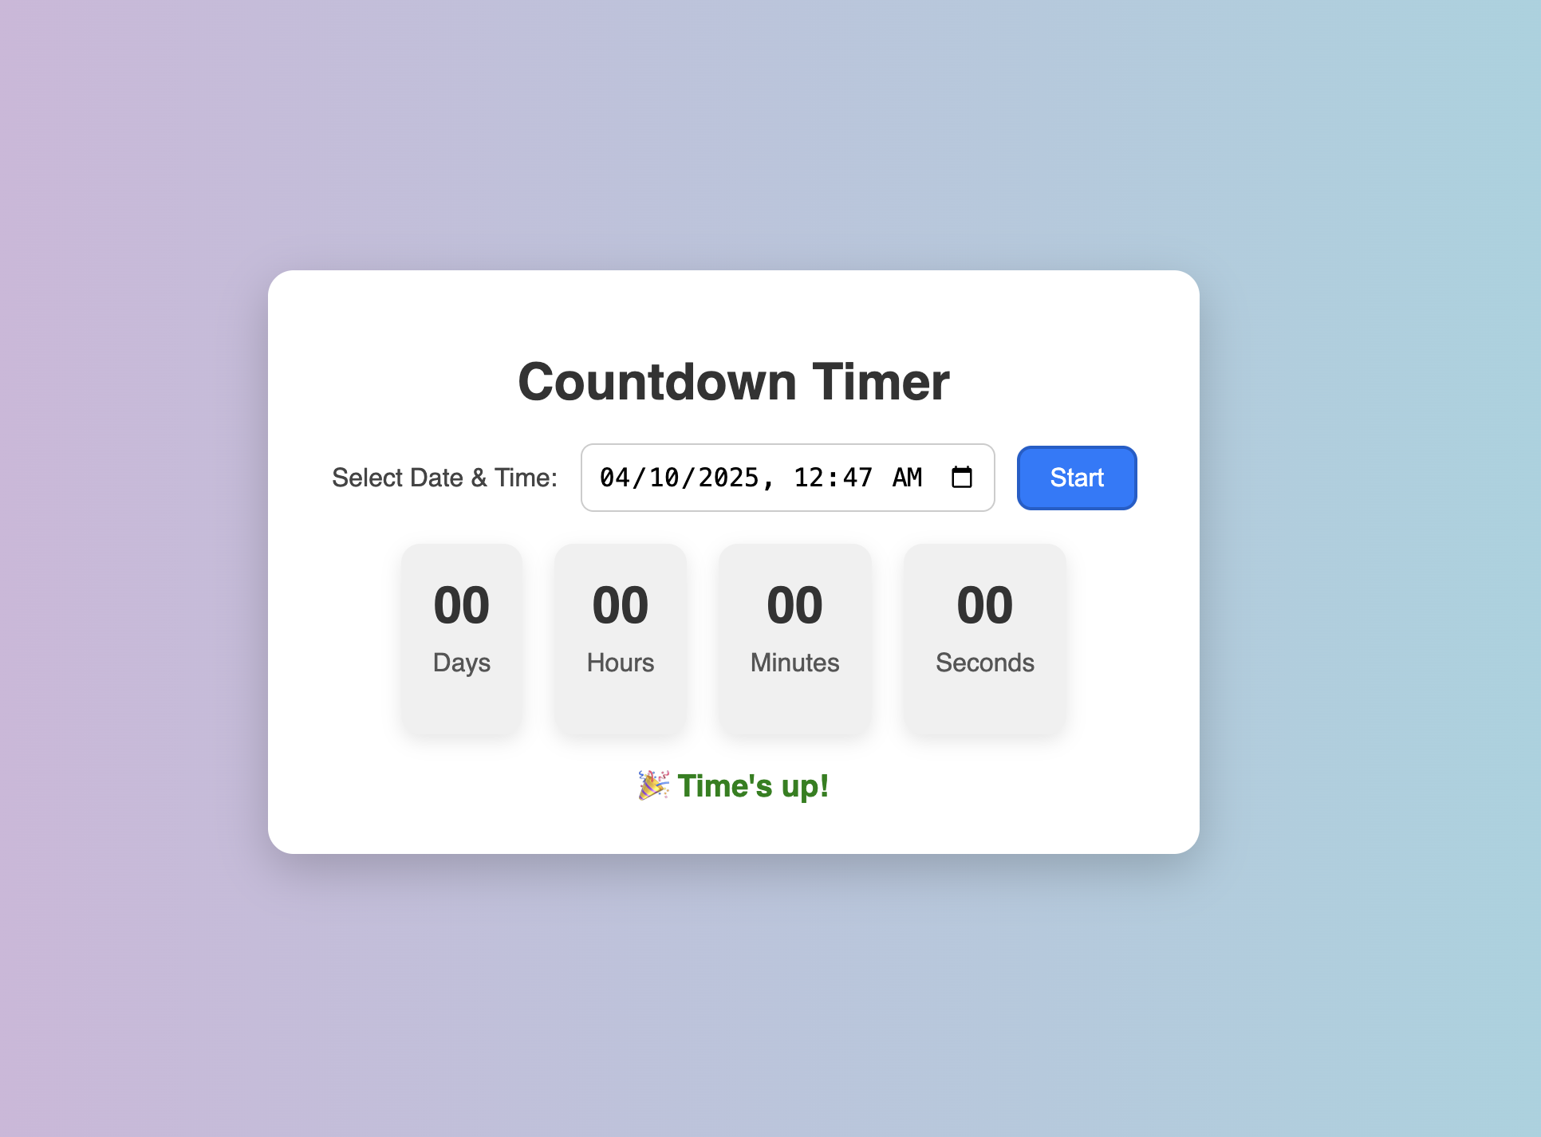
UI Preview
Set time and Date for countdown
Message appears when timer stops

Slide 8
Future Improvements
- Add pause/resume button
- Store countdown state in localStorage
- Allow multiple timers
- Add sound notification

